Slide 1
Smart Support
Final Project Report
Submitted by :
NAVIN KUMAR SINGH (21f1003002)
UDAY RAVI PATIL (21f1003481)
KRISHU GUPTA (21f1003442)

Slide 2
User Requirements & User Stories

Slide 3
User Requirements
Our team identified the following users for the Support Ticket App:
Primary Users: Students
Secondary Users: Support team members
Tertiary Users: Administration members

Slide 4
User Stories (Primary Users)
Student
As a student, I want to be able to create a new support ticket so that I can get help with my queries and concerns.
As a student, I want to be able to search for similar tickets before creating a new one so that I don't have to create a duplicate ticket.
As a student, I want to be able to upvote an existing ticket if it's similar to my concern or query so that the support team can prioritize the most popular concerns.
As a student, I want to be able to see the status of my ticket and updates made by the support team so that I can stay updated on the progress of my concern or query.
As a student, I want to be able to see a history of all my tickets and their status so that I can keep track of my past concerns and queries.
As a student, I want to be notified when the support team updates my ticket or when the status of my ticket changes so that I can stay updated on the progress of my concern or query.

Slide 5
User Stories (Secondary Users)
Support team
As a support team member, I want to be able to see a list of all the support tickets sorted by upvotes and date so that I can and respond to them in a timely manner.
As a support team member, I want to be able to update the status (open, resolved) of a support ticket so that the student knows the progress of their concern or query.
As a support team member, I want to be able to see the history of a support ticket so that I can understand the student's previous concerns and queries.

Slide 6
User Stories (Tertiary Users)
Administration
As an administrator, I want to be able to see a list of all the support tickets and their status so that I can monitor the support activities of the program.
As an administrator, I want to be able to see the history of support tickets sorted by upvotes and date so that I can understand the concerns and queries of the students.
As an administrator, I want to be able to add new tags so that I can control the allowed types of tickets.
As an administrator, I want to be able to assign different tags to different support team members so that they will be able to see only the tickets with relevant tags assigned to them.

Slide 7
User Stories (Tertiary Users continued…)
As an administrator, I want to be able to see the support tickets categorized by tags so that I can monitor the types of concerns and queries the students are facing.
As an administrator, I want to be able to send a notification when a support ticket has been resolved, so that I am make aware the concerned users
As an administrator, I want to be able to add the support query and response to the FAQ section categorised by tags so that an updated FAQ will be readily available to students.
As an administrator, I want to be able to allow users to enrol as students, support staff and admin, so that new users can access the platform

Slide 8
Storyboard

Slide 9
A student is facing a problem with her course and wants to contact the support team. She accesses the support ticketing system through the university website.

Slide 10
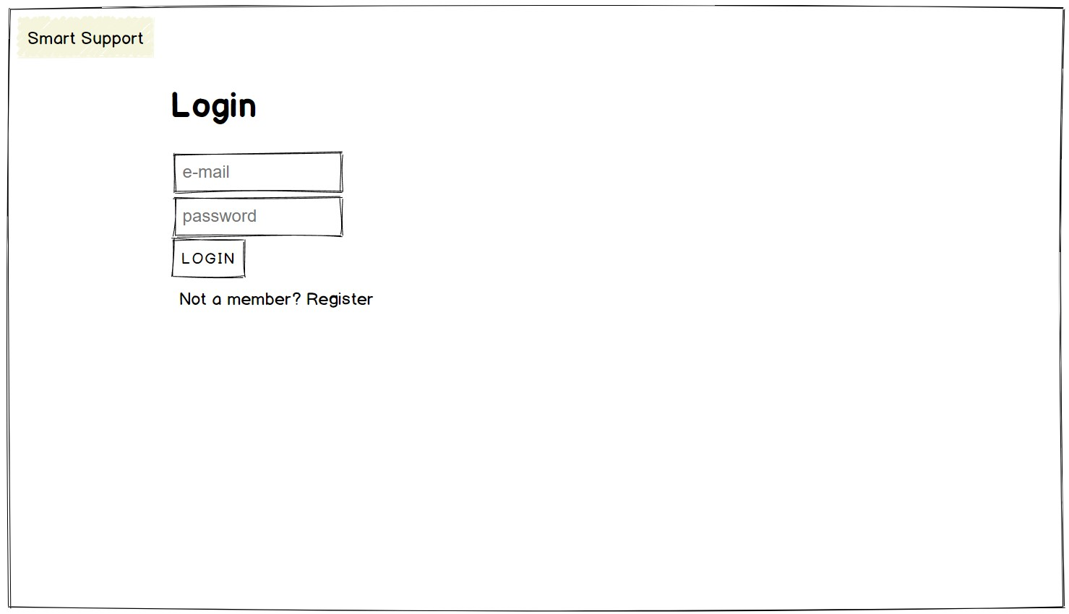
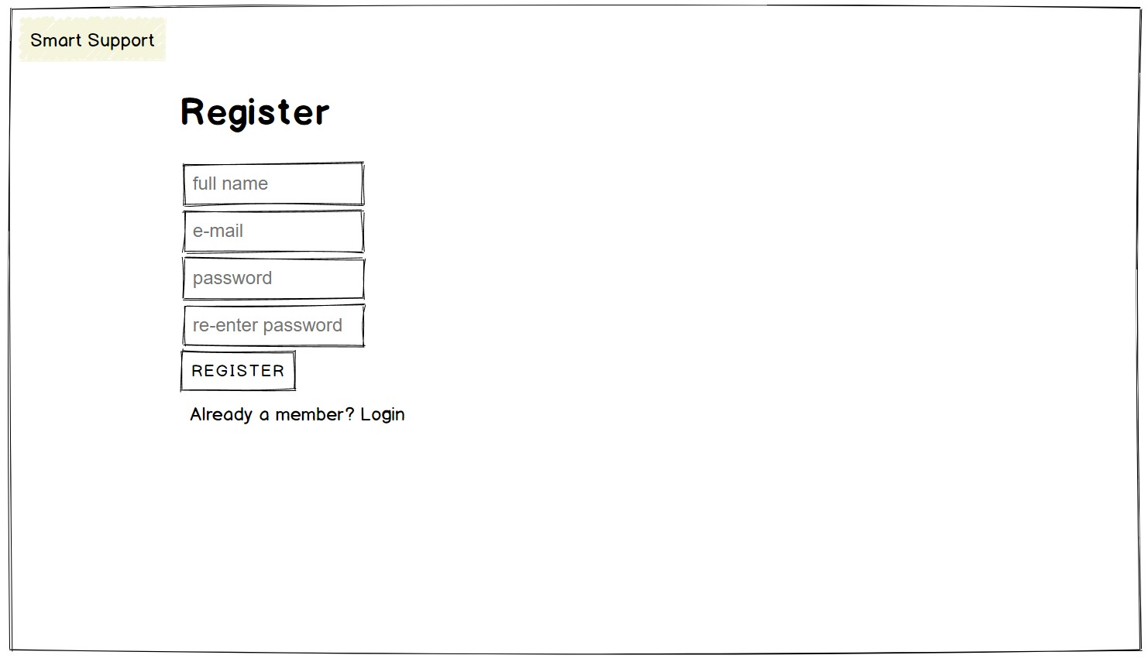
The student is presented with a login page where she needs to enter her credentials to access the support ticketing system. She can also click on Register link if she is new to the system.

Slide 11
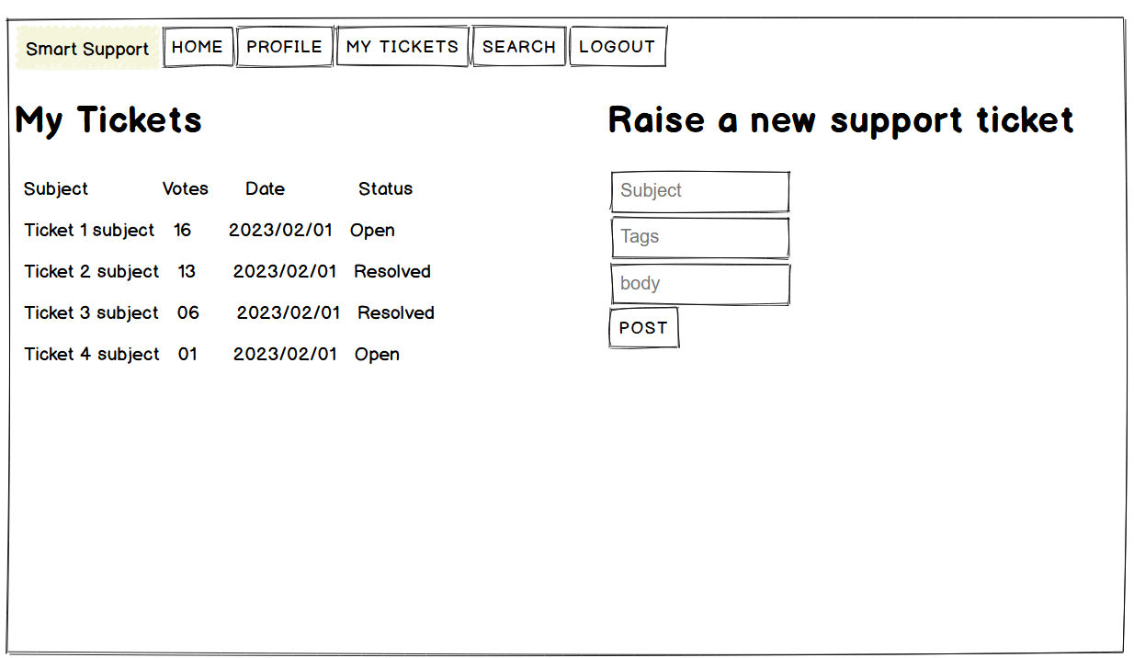
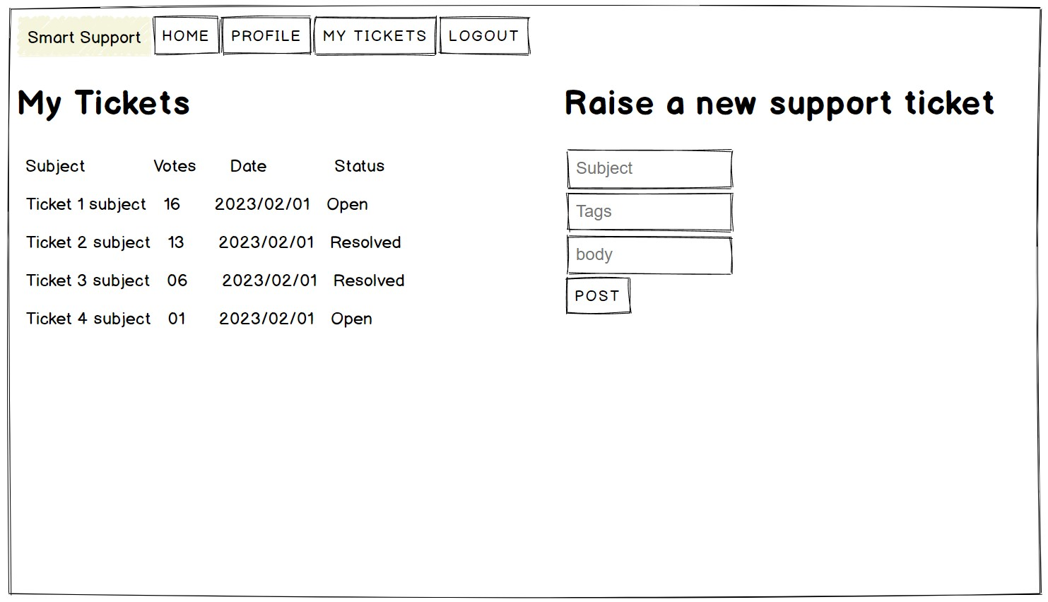
After logging in, the student is directed to the home page of the support ticketing system where she can create a new ticket or view her existing tickets.

Slide 12
In Raise a new support ticket form she can enter the details of her query or concern.
The system automatically checks if there are any similar tickets already created by other students.
If there are other similar tickets, the system displays the existing tickets to the student and prompts them to check if their concern has already been addressed.
She can also upvote an existing ticket.

Slide 13
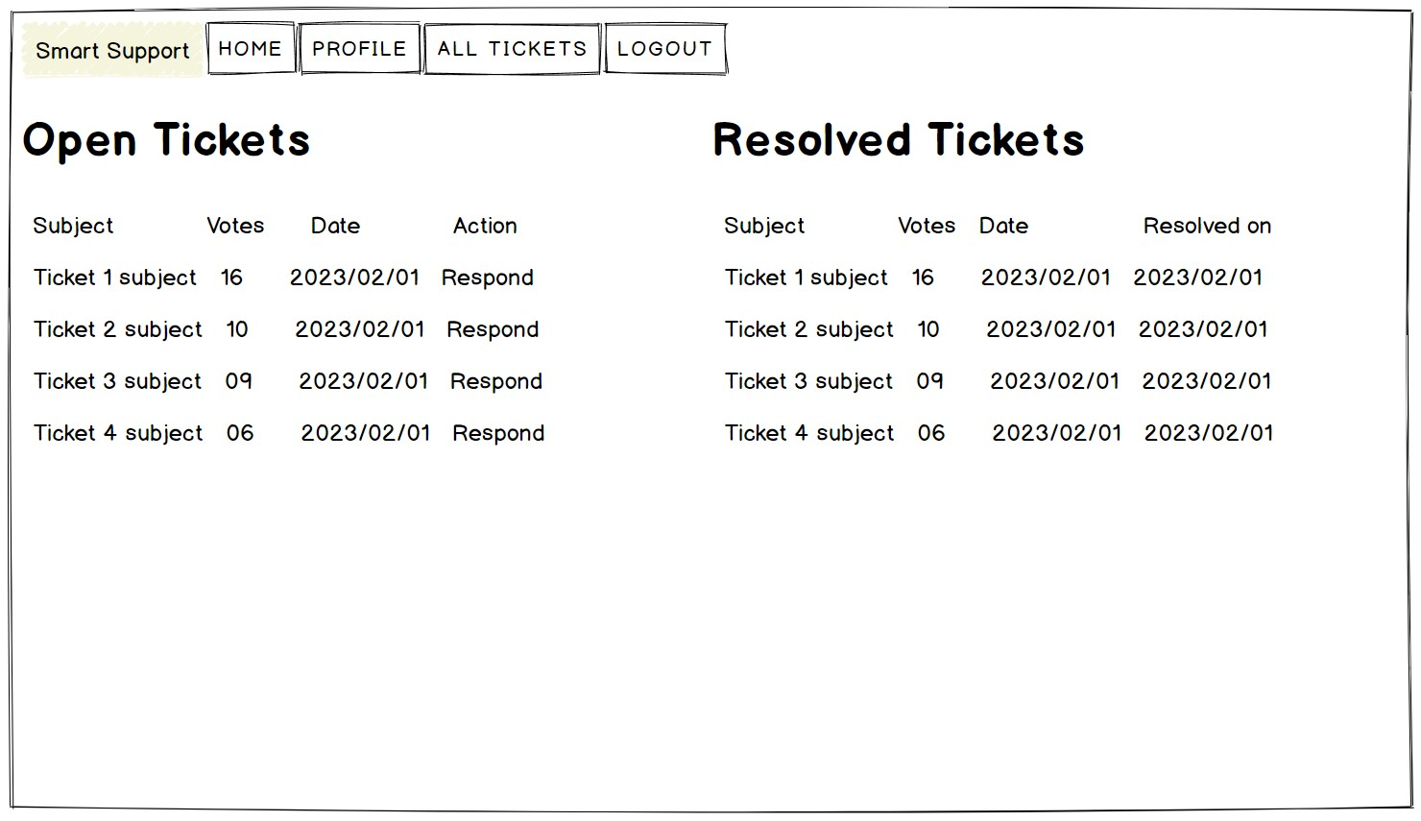
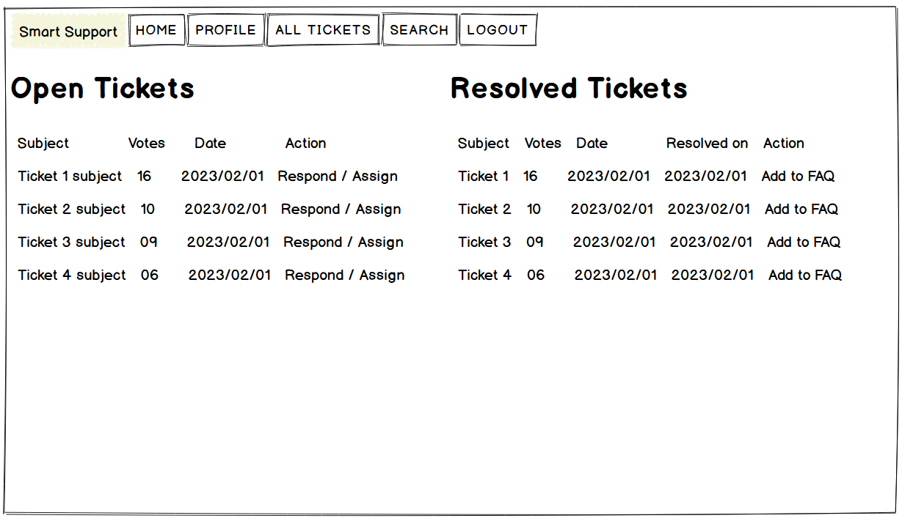
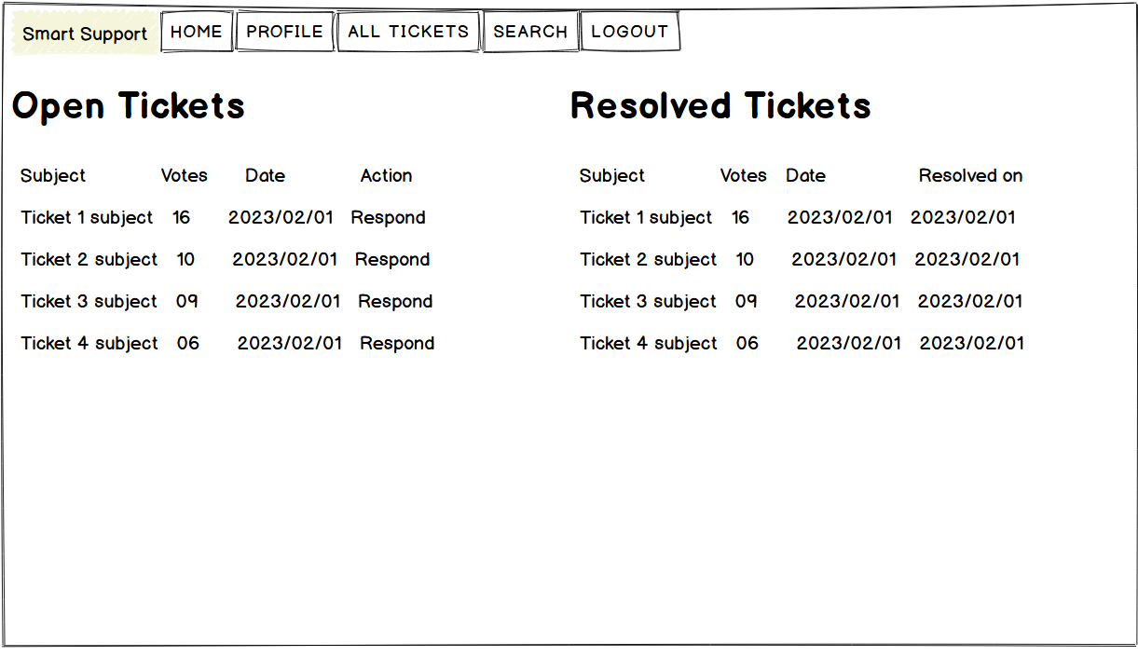
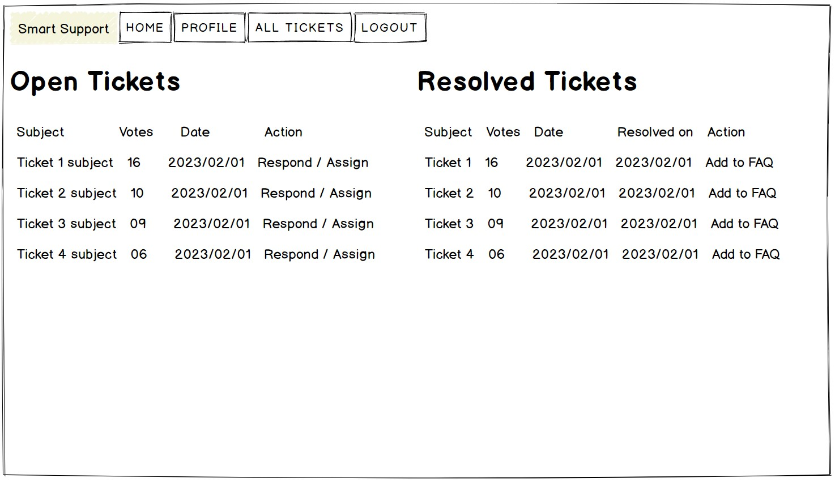
Support Dashboard
Admin Dashboard
The system updates the ticket with the number of upvotes it has received and displays the most popular tickets at the top of the list on support and admin dashboards.

Slide 14
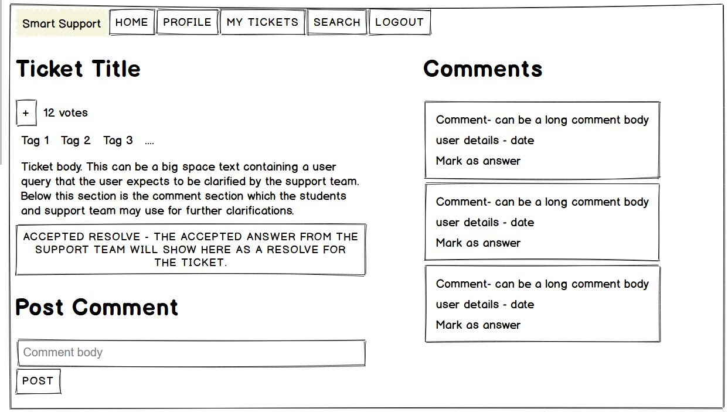
If the student decides to add a comment to the existing ticket instead of creating a new one, she can do so by visiting the relevant Ticket page

Slide 15
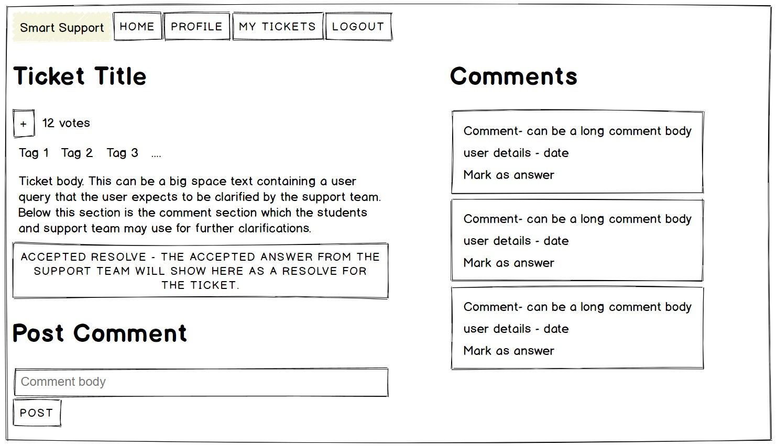
Support Dashboard
Ticket Page
The support team receives the ticket and begins working on a solution.
They can view the ticket, add comments, and update the ticket status as they work on the issue.

Slide 16
Student Dashboard
Once the support team resolves the issue, they update the ticket status to Resolved and notify the student.
The student receives a notification about the updated status of the ticket and can view the solution provided by the support team.
The status of ticket changes from Open to Resolved on the Student Dashboard

Slide 17
Admin Dashboard
Admins can see the list of all Open and Resolved tickets on their dashboard sorted by upvotes and date.
They can assign the tickets to specific support users or they can respond to the tickets themselves.
They can also add any of the resolved tickets to FAQs list.

Slide 18
Schedule and Design

Slide 19
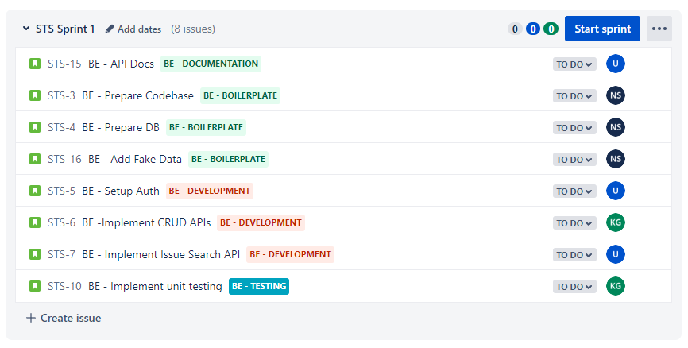
Sprint 1

Slide 20
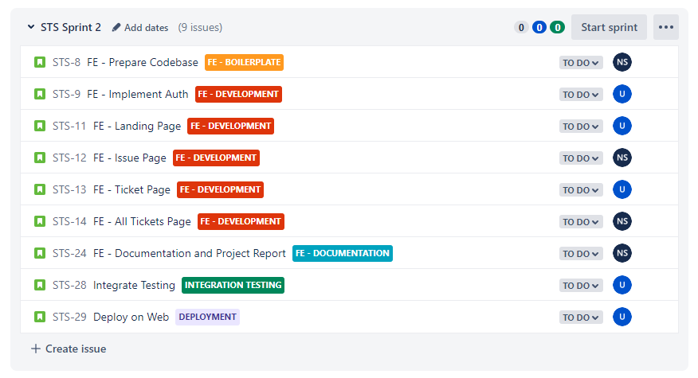
Sprint 2

Slide 21
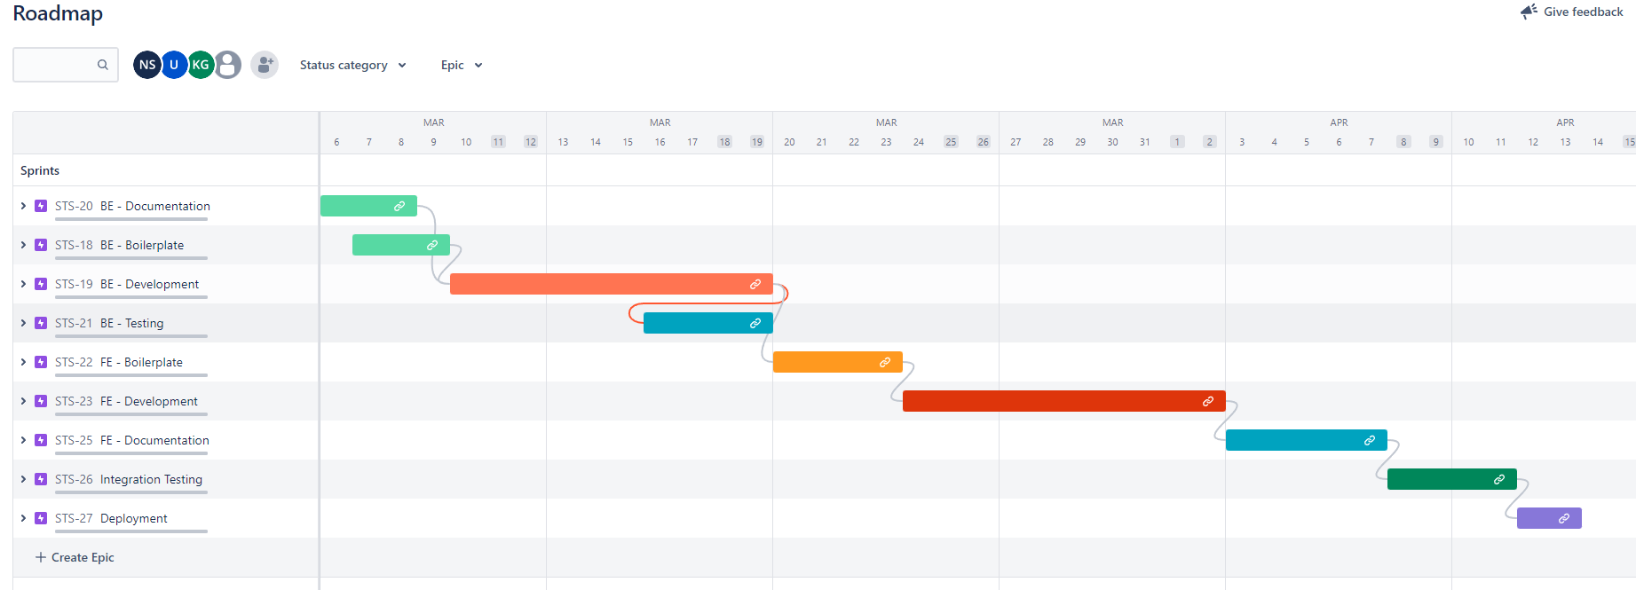
Gant Chart

Slide 22
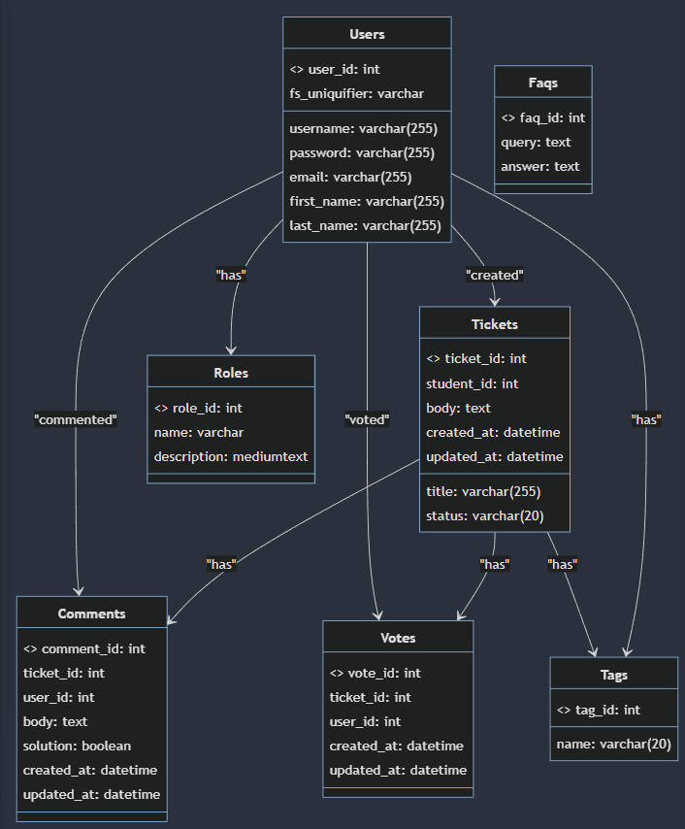
Class Diagram

Slide 23
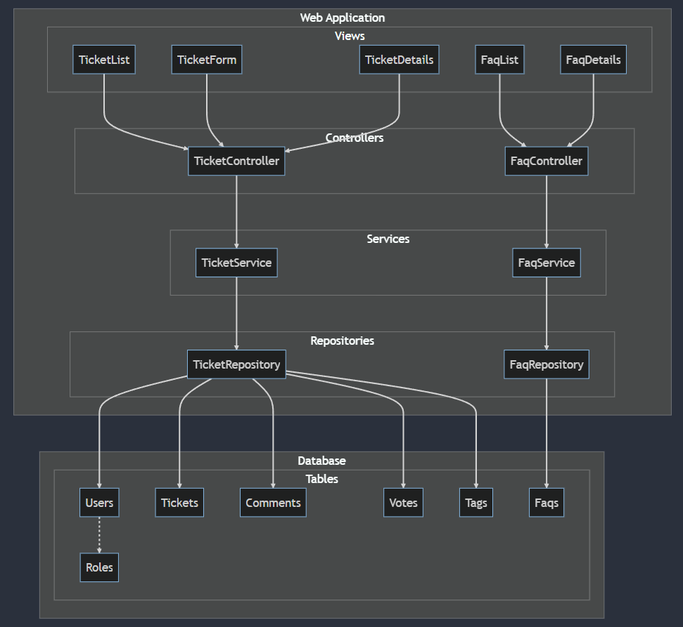
Component Design

Slide 24
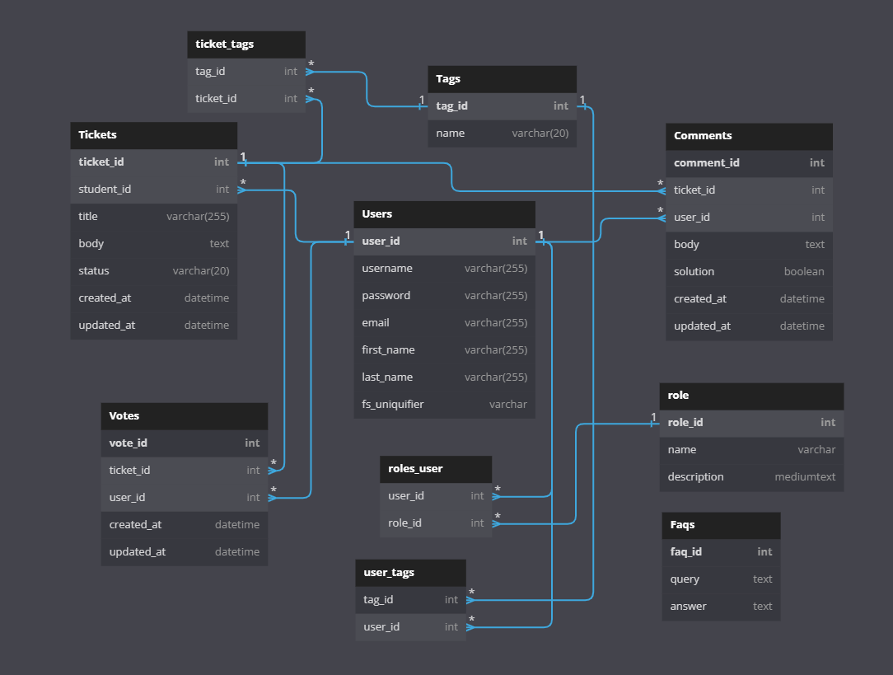
DB Schema

Slide 25
Scrum Meeting 1: Date: 2023-02-10 Time: 9:00 PM
Attendees:
Uday
Navin
Krishu
Agenda:
Getting to know each other
Assign roles
Discuss general structure and timeline of the project
Minutes:
Each member introduced themselves.
Roles were discussed
Discussed general structure of the project.

Slide 26
Scrum Meeting 2: Date: 2023-02-15 Time: 10:00 PM
Attendees:
Uday
Navin
Agenda:
Review of Milestone 2 Submission
Discussion of upcoming milestone goals
Standardize theme of all wireframes
Minutes:
Some mock user stories discussed.
General theme for all wireframe pages were discussed.
A few mock wireframes were developed.
The team discussed other business, including the need for a clearer definition of roles and responsibilities.

Slide 27
Scrum Meeting 3: Date: 2023-02-23 Time: 9:30 PM
Attendees:
Uday
Navin
Agenda:
Finalise Milestone 2 Submission
Discussion of upcoming milestone goals
Minutes:
Final user stories and wireframe were designed by Navin
Uday recommended some changes to wireframes
Final Milestone 2 draft was prepared.

Slide 28
Scrum Meeting 4: Date: 2023-03-02 Time: 10:30 PM
Attendees:
Uday
Navin
Agenda:
Discuss tools to be used for Milestone 3
Assign roles
Create Timeline of the project.
Minutes:
Jira was decided upon for project scheduling
Two sprints were discussed and scheduled on Jira
Categories (Epics) and their issues/tasks were created and added to their respective sprints.
Timeline was decided for each issues/task.
Issues/Tasks were assigned to each member.

Slide 29
API Endpoints

Slide 30
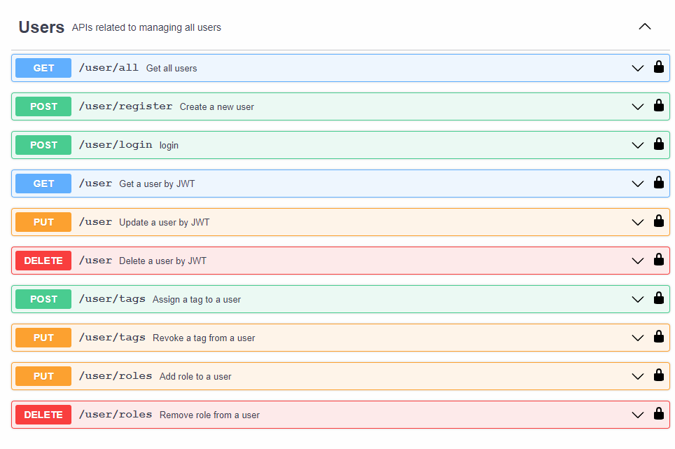
User Endpoints

Slide 31
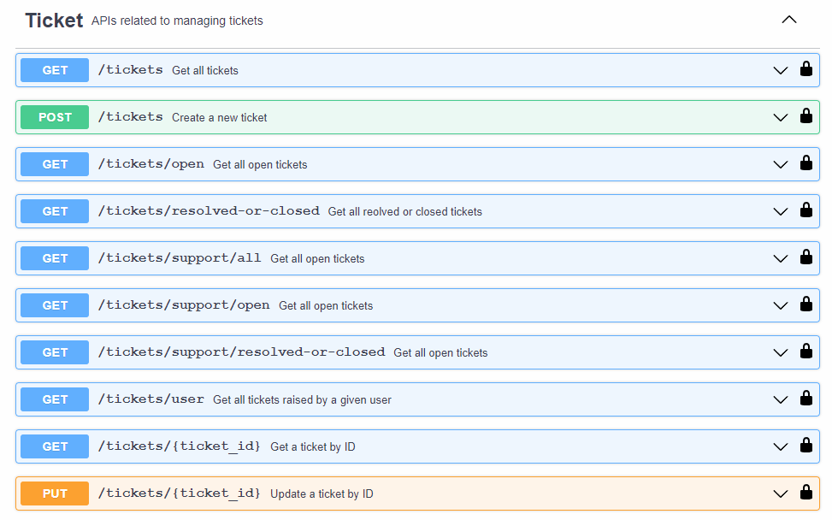
Ticket Endpoints

Slide 32
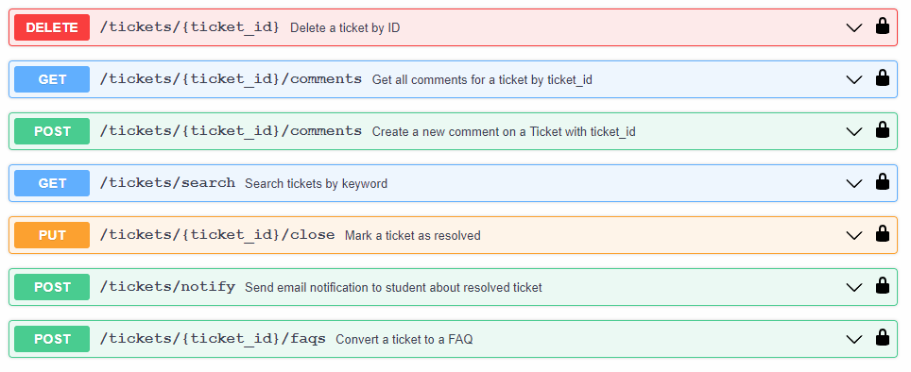
Ticket Endpoints continued…

Slide 33
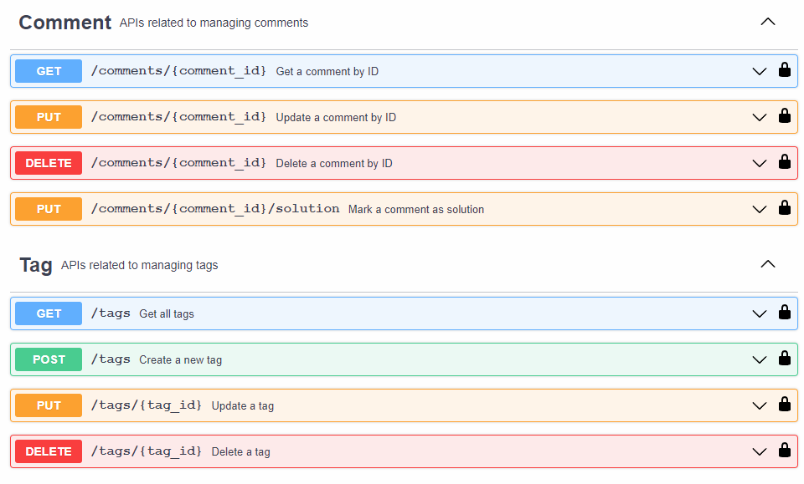
Comment and Tag Endpoints

Slide 34
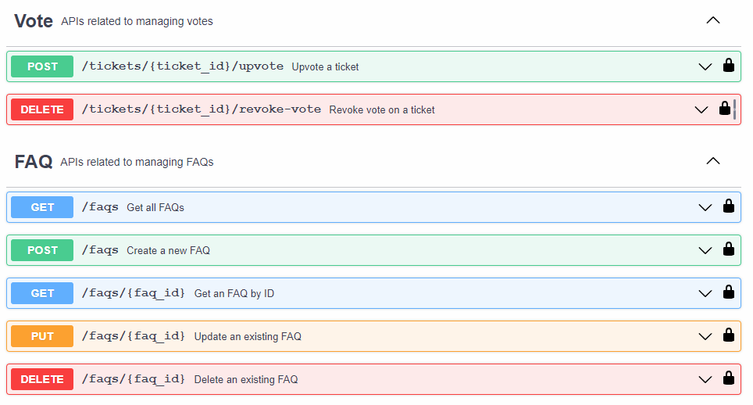
Vote and FAQs Endpoints

Slide 35
Test Cases

Slide 36
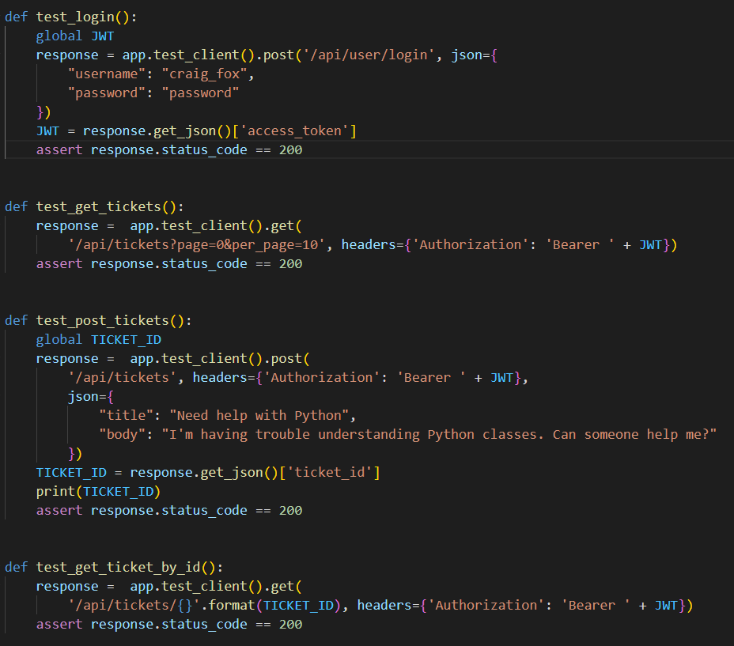
We have implemented API testing using pytest for CRUD APIs for the Ticket model in our application

Slide 37
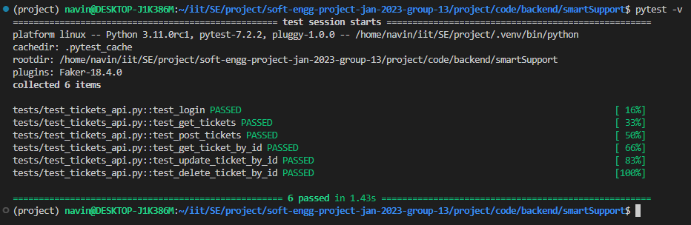
So far we have implemented 6 test cases for Ticket APIs (including 1 for the Login API)

Slide 38
Some other test cases that we intend to implement in future versions

Slide 39
Test to get all comments for a valid ticket ID
Page being tested: get_comments function
Inputs: A valid ticket ID in the URL and an authenticated JWT token
Expected output: A JSON response with status code 200 and a list of all comments for the given ticket ID in descending order of creation time
Actual output: Same as expected output
Result: Success

Slide 40
Test to get a single comment by ID
Page being tested: get_comment function
Inputs: A valid comment ID in the URL and an authenticated JWT token
Expected output: A JSON response with status code 200 and the comment details for the given ID
Actual output: Same as expected output
Result: Success

Slide 41
Test to add a new comment to a valid ticket
Page being tested: post_comment function
Inputs: A valid ticket ID in the URL, a valid JWT token, and a JSON payload with a "body" field containing the comment text
Expected output: A JSON response with status code 200 and the details of the newly created comment, including the comment ID and creation time
Actual output: Same as expected output
Result: Success

Slide 42
Test to update an existing comment
Page being tested: put_comment function
Inputs: A valid comment ID in the URL, a valid JWT token, and a JSON payload with a "body" field containing the updated comment text
Expected output: A JSON response with status code 200 and the details of the updated comment, including the comment ID and creation time
Actual output: Same as expected output
Result: Success

Slide 43
Test to delete an existing comment
Page being tested: delete_comment function
Inputs: A valid comment ID in the URL and a valid JWT token
Expected output: A JSON response with status code 204 and no content
Actual output: Same as expected output
Result: Success

Slide 44
Test to mark a comment as the solution for a ticket
Page being tested: mark_comment_as_solution function
Inputs: A valid comment ID in the URL and a valid JWT token
Expected output: A JSON response with status code 200 and the details of the marked comment, including the comment ID and creation time. The associated ticket status should also be updated to "Resolved"
Actual output: Same as expected output
Result: Success

Slide 45
Besides the tests mentioned in previous pages, there can be tests written for:
User CRUD operations
Tickets Voting operations
Tags CRUD operations
FAQs CRUD operations

Slide 46
Implementation details

Slide 47
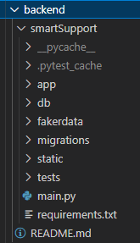
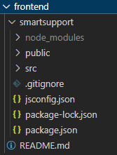
Folder structure code/ backend/smartSupport frontend/smartsupport
Backend Folder Structure:
Frontend Folder Structure:

Slide 48
Tech Stack
Backend:
Flask – as scripting Framework
SQLite – for database
MailHog – for SMTP testing
Faker – for generating fake data
PyTest – for testing
Frontend:
Vue3 – as scripting Framework
Bootstrap 5 – as css Framework

Slide 49
Tools used
vsCode for IDE
dbBrowser for managing SQLite database
MailHog for SMTP testing
https://dbdiagram.io/ for generating DB Schema
https://imagineui.netlify.app/ for generating wireframes
JIRA for project management and scheduling
Github for version control

Slide 50
Steps to start Backend server
Step 1:
CD to `code/backend/smartSupport` directory.
Step 2:
Run `pip install requirements.txt` or `pip3 install requirements.txt` to install all dependencies
Step 3:
Run `python main.py` or `python3 main.py`
To start MailHog server run:
`~/go/bin/MailHog`
or
`go/bin/MailHog`
Mailhog installation guide
https://github.com/mailhog/MailHog

Slide 51
Steps to start Frontend server
For project setup run:
`npm install`
To start Server run:
`npm run serve`
To compile and minify for production run:
`npm run build`

Slide 52
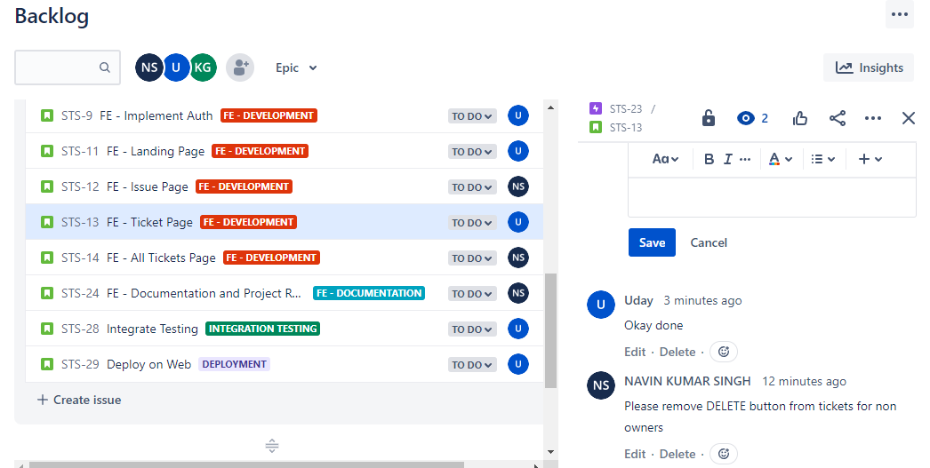
Issue Tracking and Reporting
We used JIRA for Issue Tracking:

